Slide 1
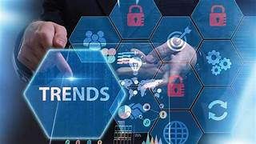
Trends in the IT Industry
ANNMARIA SUSAN KURIAN

Slide 2
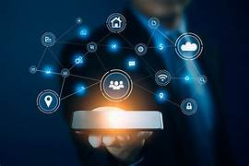
Introduction to IT Trends
Why IT Trends Matter?
The IT industry is rapidly evolving, shaping how we live, work, and interact with technology. From artificial intelligence (AI) to blockchain and cybersecurity, new trends are driving innovation across all sectors.

Slide 3
Key Factors Driving IT Trends:
Digital Transformation: Businesses adopting cloud, AI, and automation.
Demand for Cybersecurity: Increase in cyber threats and data breaches.
Emerging Technologies: 5G, IoT, Quantum Computing reshaping industries.
Remote & Hybrid Work: New tools for collaboration and security.

Slide 4
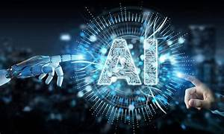
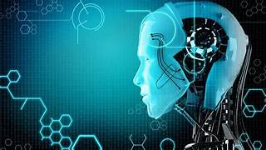
Artificial Intelligence (AI) & Machine Learning (ML)
AI and ML are transforming businesses, healthcare, finance, and daily life by automating complex tasks.
AI/ML Trends:
Generative AI: Tools like ChatGPT, Google Gemini creating human-like text, images, and code.
AI in Healthcare: Predictive analytics, AI-assisted diagnosis, robotic surgeries.
AI in Business: Fraud detection, customer service chatbots, personalized recommendations.

Slide 5
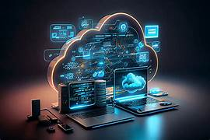
Cloud Computing & Edge Computing
What is Cloud Computing?
Cloud computing enables remote access to storage, applications, and services over the internet.
Latest Cloud Computing Trends:
Hybrid & Multi-Cloud: Combining public, private, and on-premise cloud services.
Serverless Computing: Developers don’t manage infrastructure, increasing scalability.
AI in Cloud: Google Cloud AI, AWS AI services integrating ML for predictive analytics.

Slide 6
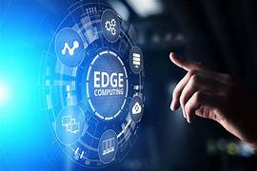
Edge Computing – The Next Step
Edge computing processes data closer to the user/device instead of a centralized cloud, reducing latency.
Example: Autonomous vehicles process data locally to avoid accidents in real-time.
5G + Edge Computing = Faster IoT (e.g., smart cameras, industrial automation).

Slide 7
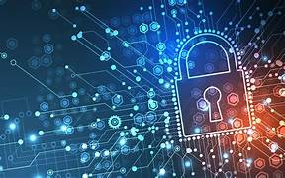
Cybersecurity & Zero Trust Architecture
Why is Cybersecurity Important?
Cybercrime damages are expected to reach $10.5 trillion by 2025 (Cybersecurity Ventures).
Ransomware attacks are increasing by 300% yearly.
Top Cybersecurity Trends:
Zero Trust Security: “Never trust, always verify” security model.
AI in Cybersecurity: AI-powered threat detection (e.g., Darktrace, IBM Watson Security).
Biometric Authentication: Facial recognition, fingerprint scanning replacing passwords.

Slide 8
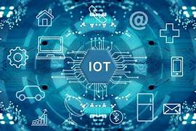
Internet of Things (IoT) & Smart Devices
What is IoT?
IoT refers to connected devices that collect, process, and share data.
Example: Smart refrigerators, smartwatches, industrial automation sensors.
Current IoT Trends:
Smart Cities: IoT in traffic management, waste collection, energy grids.
Healthcare IoT: Remote patient monitoring, AI-based wearables (e.g., Apple Watch ECG).
Security Concerns: IoT devices prone to hacking (e.g., Mirai botnet attack on IoT devices).

Slide 9
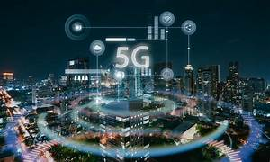
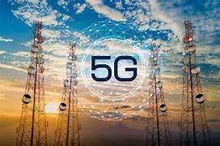
5G Technology
Why is 5G a Game-Changer?
Speeds 100x faster than 4G (10 Gbps).
Ultra-low latency (1 millisecond response time).
5G Applications:
Autonomous Vehicles: Cars communicate with each other for accident prevention.
Remote Healthcare: AI-powered remote surgeries via 5G robotic arms.
Gaming & VR: High-speed streaming for cloud gaming and metaverse experiences.

Slide 10
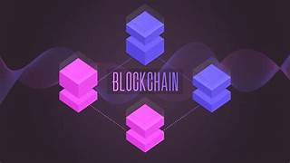
Blockchain & Decentralized Technologies
Beyond Bitcoin: Blockchain Applications
Supply Chain Management: Ensures product authenticity (e.g., IBM Food Trust for tracking food supply chains).
Decentralized Finance (DeFi): Peer-to-peer transactions without banks.
Smart Contracts: Automated agreements executing when conditions are met.

Slide 11
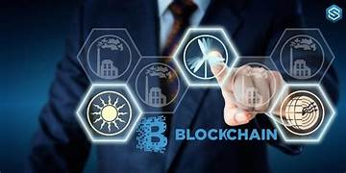
Challenges:
High energy consumption (Bitcoin mining).
Regulatory concerns (governments restricting cryptocurrency).
Future of Blockchain:
Green Blockchain Technologies reducing environmental impact.
Adoption in Healthcare & Legal Sectors.

Slide 12
Metaverse & Extended Reality (AR/VR)
What is the Metaverse?
A virtual world where people interact, work, and socialize through digital avatars.
Metaverse Applications:
Education: Virtual universities (e.g., Stanford offering Metaverse-based classes).
Workplaces: Companies like Meta, Microsoft developing virtual offices.
Retail: Virtual shopping experiences (e.g., Nike’s Metaverse sneaker store).

Slide 13
Quantum Computing – The Future of IT
How Does Quantum Computing Work?
Uses Qubits (quantum bits) instead of binary 0s & 1s, making it exponentially faster.
Quantum Computing Applications:
Drug Discovery: Simulates complex molecular reactions.
Finance: Optimizes stock market predictions.
Cryptography: Can break traditional encryption (leading to new security challenges).

Slide 14
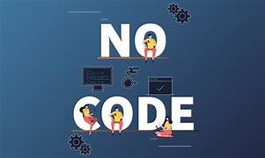
Low-Code & No-Code Development
Platforms that allow app development without extensive coding.
Examples: Microsoft PowerApps, Bubble.io.
Impact: Accelerates digital transformation, reduces development costs.

Slide 15
IT Industry Job Trends & Skill Demand
Top IT Jobs in 2025: AI Engineer, Cloud Security Expert, Blockchain Developer.
Skills in Demand: AI/ML, cybersecurity, data analytics, cloud computing.
Upskilling Importance: Lifelong learning to stay relevant in the industry.

Slide 16
THANK YOU

